Slide 1
Design and Analysis of Algorithms
CSE 2202
Department of Computer Science and Engineering
University of Dhaka

Slide 2
Recommended Textbooks
Cormen, T.H., Leiserson, C.E., Rivest, R.L. and Stein, C., 2022. Introduction to algorithms. MIT press.
Goodrich, M.T., Tamassia, R. and Goldwasser, M.H., 2013. Data structures and algorithms in Python. John Wiley & Sons Ltd.

Slide 3
Time complexity
Amount of time needed for the algorithm to finish
Best case
Average case
Worst case
Not actual time: related to size of input.
Big O notation

Slide 4
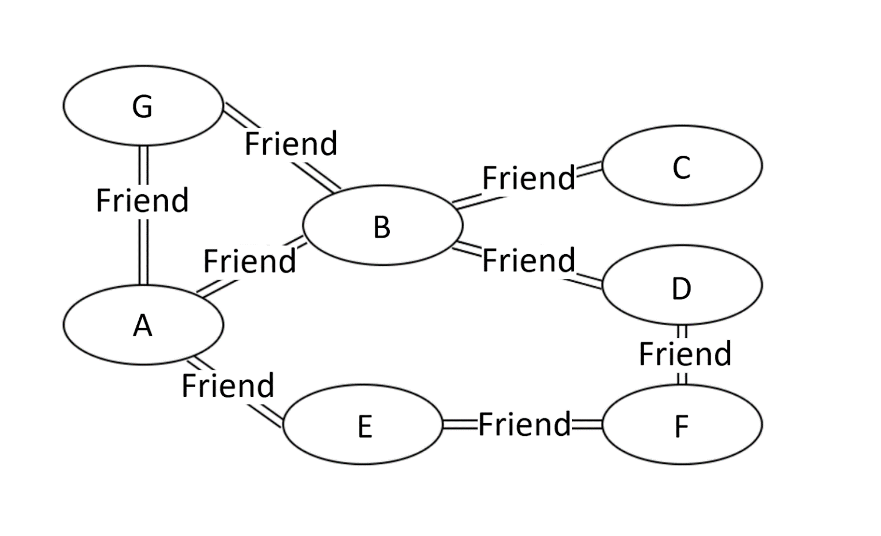
Graph
Graph is probably the data structure that has the closest resemblance to our daily life.
There are many types of graphs describing the relationships in real life.

Slide 5
Graph Variations
Variations:
A connected graph has a path from every vertex to every other
In an undirected graph:
Edge (u,v) = edge (v,u)
No self-loops
In a directed graph:
Edge (u,v) goes from vertex u to vertex v, notated u→v

Slide 6
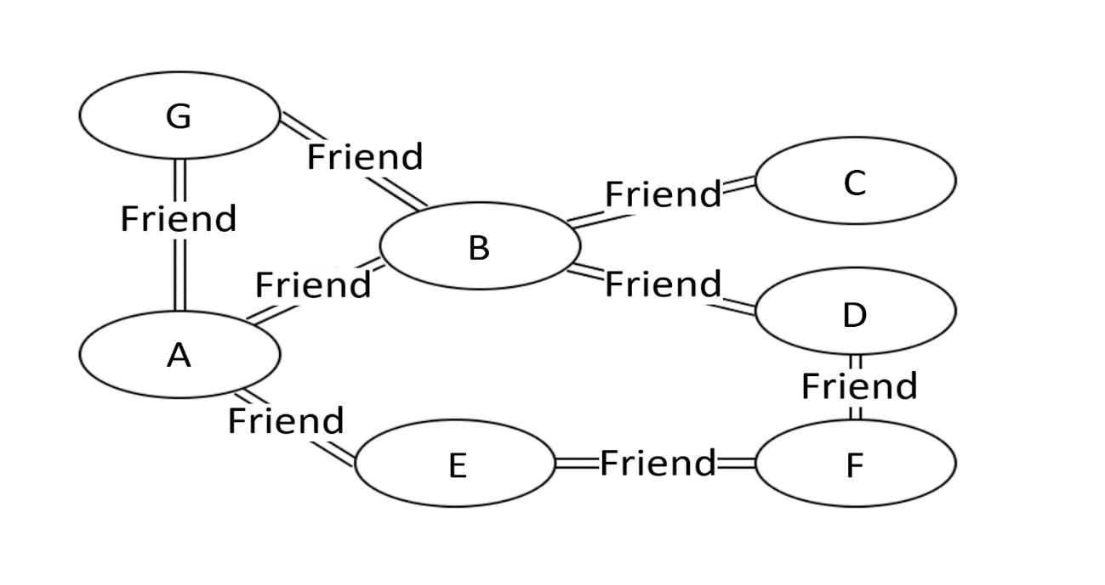
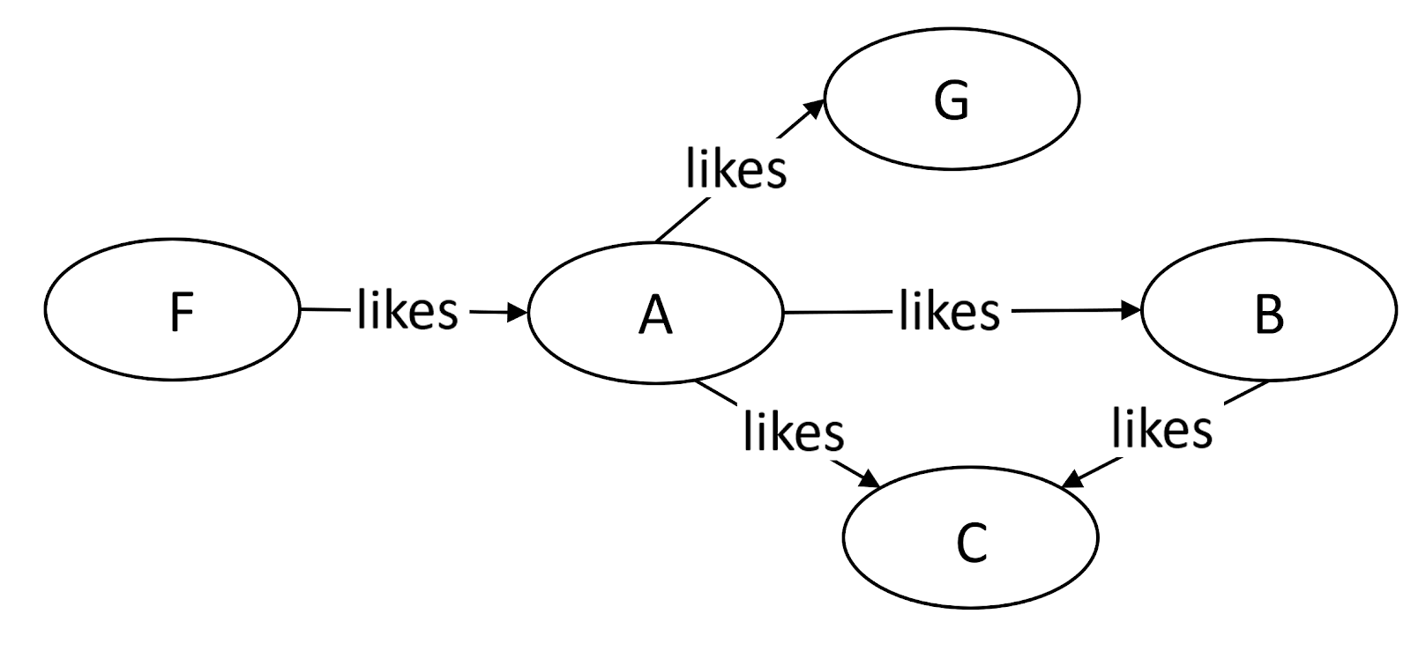
Graph Variations

Slide 7
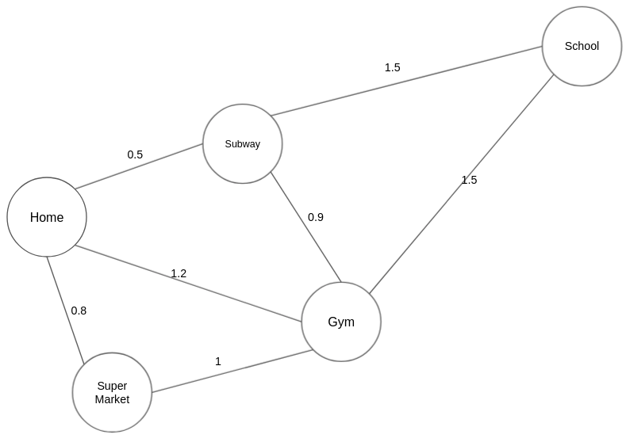
Graph Variations
More variations:
A weighted graph associates weights with either the edges or the vertices
E.g., a road map: edges might be weighted w/ distance
A multigraph allows multiple edges between the same vertices
E.g., the call graph in a program (a function can get called from multiple points in another function)

Slide 8
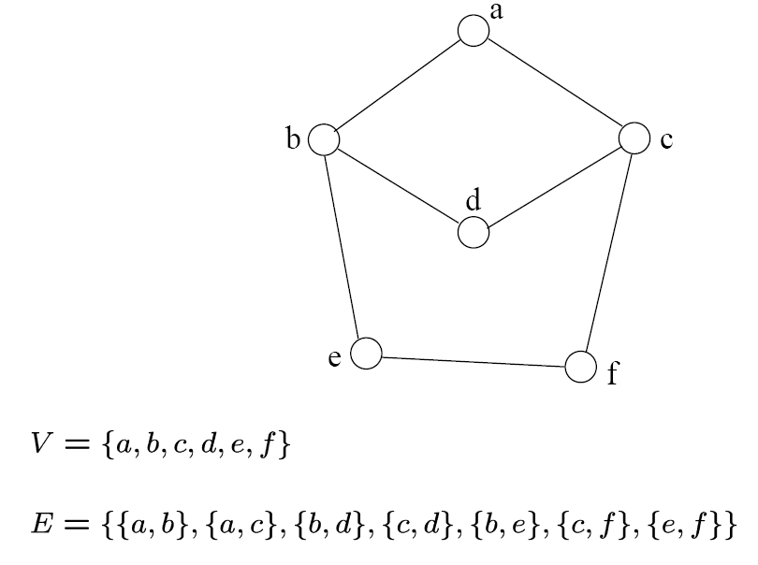
Graph - Definition
A graph G=(V, E) consists a set of vertices, V, and a set of edges, E.
Each edge is a pair of (v, w), where v, w belongs to V
If the pair is unordered, the graph is undirected; otherwise it is directed
{a,b}
{a,c}
{b,d}
{c,d}
{b,e}
{c,f}
{e,f}
An undirected graph

Slide 9

Definition
Path: the sequence of vertices to go through from one vertex to another.
a path from A to C is [A, B, C], or [A, G, B, C], or [A, E, F, D, B, C].
Path Length: the number of edges in a path.
Cycle: a path where the starting point and endpoint are the same vertex.
[A, B, D, F, E] forms a cycle. Similarly, [A, G, B] forms another cycle.

Slide 10

Definition
Degree of a Vertex: the term “degree” applies to unweighted graphs. The degree of a vertex is the number of edges connecting the vertex.
the degree of vertex A is 3 because three edges are connecting it.
In-Degree: “in-degree” is a concept in directed graphs. If the in-degree of a vertex is d, there are d directional edges incident to the vertex.
In Figure 2, A’s indegree is 1, i.e., the edge from F to A.
Out-Degree: “out-degree” is a concept in directed graphs. If the out-degree of a vertex is d, there are d edges incident from the vertex.
A’s outdegree is 3, i,e, the edges A to B, A to C, and A to G.

Slide 11
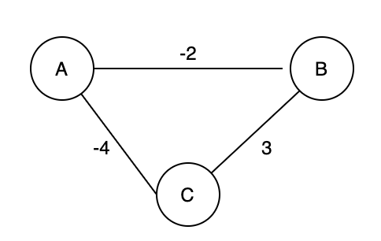
Definition
Connectivity: if there exists at least one path between two vertices, these two vertices are connected.
A and C are connected because there is at least one path connecting them.
Negative Weight Cycle: In a “weighted graph”, if the sum of the weights of all edges of a cycle is a negative value, it is a negative weight cycle.
In the Figure the sum of weights is -3.

Slide 12
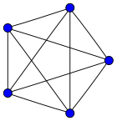
Definition
Complete Graph
a complete graph is a simple undirected graph in which every pair of distinct vertices is connected by a unique edge.
A complete digraph is a directed graph in which every pair of distinct vertices is connected by a pair of unique edges (one in each direction).
How many edges are there in an N-vertex complete graph?

Slide 13
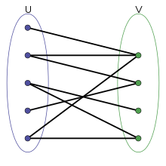
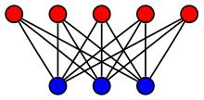
Definition
Bipartite Graph
a bipartite graph (or bigraph) is a graph whose vertices can be divided into two disjoint and independent sets

Slide 14
Definition
We will typically express running times in terms of |E| and |V| (often dropping the |’s)
If |E| ≈ |V|² the graph is dense
If |E| ≈ |V| the graph is sparse
If you know you are dealing with dense or sparse graphs, different data structures may make sense

Slide 15
Graph Representation
Two popular computer representations of a graph. Both represent the vertex set and the edge set, but in different ways.
Adjacency Matrix
Use a 2D matrix to represent the graph
Adjacency List
Use a 1D array of linked lists

Slide 16
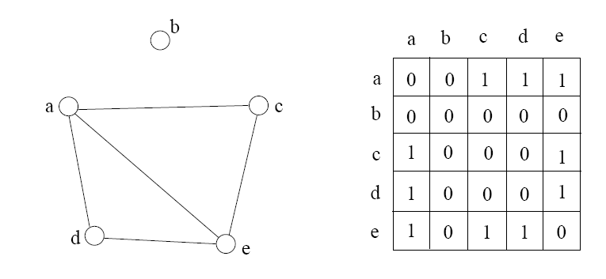
Adjacency Matrix
l

Slide 17
Simple Questions on Adjacency Matrix
Is there a direct link between A and B?
What is the indegree and outdegree for a vertex A?
How many nodes are directly connected to vertex A?
Is it an undirected graph or directed graph?
Suppose ADJ is an NxN matrix. What will be the result if we create another matrix ADJ2 where ADJ2=ADJxADJ?

Slide 18
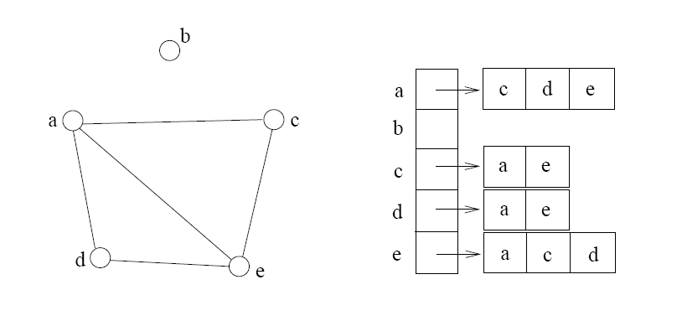
Adjacency List
If the graph is not dense, in other words, sparse, a better solution is an adjacency list

Slide 19
Adjacency Matrix Example
0
 | 0 | 1 | 2 | 3 | 4 | 5 | 6 | 7 | 8 | 9
0 | 0 | 0 | 0 | 0 | 0 | 0 | 0 | 0 | 1 | 0
1 | 0 | 0 | 1 | 1 | 0 | 0 | 0 | 1 | 0 | 1
2 | 0 | 1 | 0 | 0 | 1 | 0 | 0 | 0 | 1 | 0
3 | 0 | 1 | 0 | 0 | 1 | 1 | 0 | 0 | 0 | 0
4 | 0 | 0 | 1 | 1 | 0 | 0 | 0 | 0 | 0 | 0
5 | 0 | 0 | 0 | 1 | 0 | 0 | 1 | 0 | 0 | 0
6 | 0 | 0 | 0 | 0 | 0 | 1 | 0 | 1 | 0 | 0
7 | 0 | 1 | 0 | 0 | 0 | 0 | 1 | 0 | 0 | 0
8 | 1 | 0 | 1 | 0 | 0 | 0 | 0 | 0 | 0 | 1
9 | 0 | 1 | 0 | 0 | 0 | 0 | 0 | 0 | 1 | 0
8
2
9
1
3
7
6
4
5

Slide 20
Adjacency List Example
8
0
0
1
2
3
4
5
6
7
8
9
2 | 3 | 7 | 9
8
1 | 4 | 8
2
9
1 | 4 | 5
1
2 | 3
7
3 | 6
3
6
5 | 7
4
5
1 | 6
0 | 2 | 9
1 | 8

Slide 21
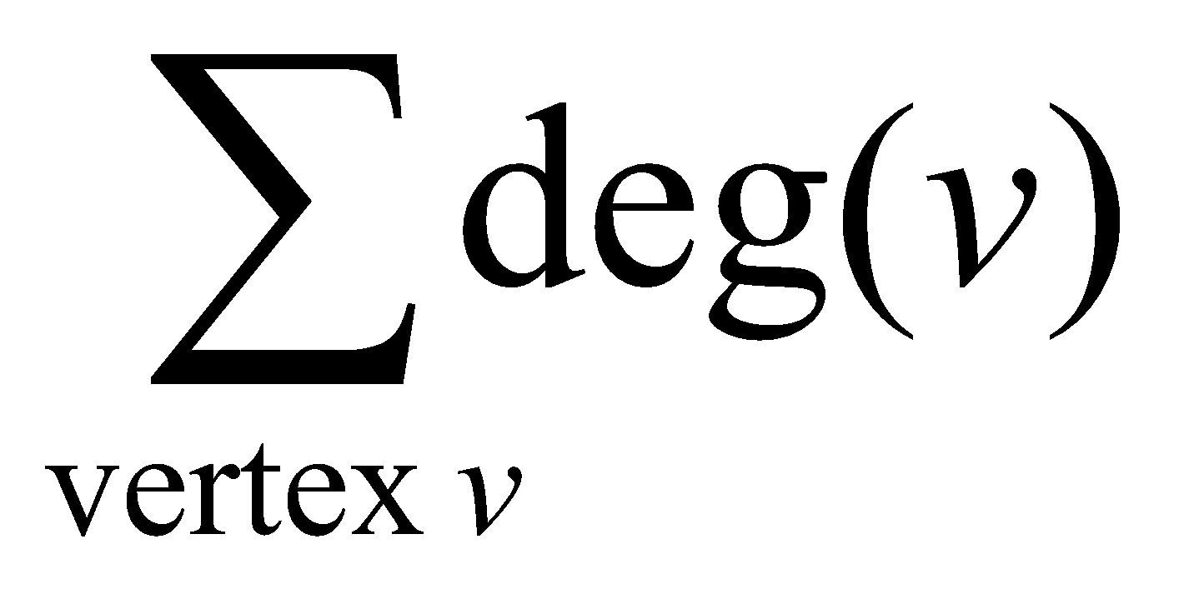

Storage of Adjacency List
The array takes up Θ(n) space
Define degree of v, deg(v), to be the number of edges incident to v. Then, the total space to store the graph is proportional to:
An edge e={u,v} of the graph contributes a count of 1 to deg(u) and contributes a count 1 to deg(v)
Therefore, Σ_{vertex v}deg(v) = 2m, where m is the total number of edges
In all, the adjacency list takes up Θ(n+m) space
If m = O(n²) (i.e. dense graphs), both adjacent matrix and adjacent lists use Θ(n²) space.
If m = O(n), adjacent list outperform adjacent matrix
However, one cannot tell in O(1) time whether two vertices are connected

Slide 22
Adjacency List vs. Matrix
Adjacency List
More compact than adjacency matrices if graph has few edges
Requires more time to find if an edge exists
Adjacency Matrix
Always require n² space
This can waste a lot of space if the number of edges are sparse
Can quickly find if an edge exists

Slide 23
Path between Vertices
A path is a sequence of vertices (v₀, v₁, v₂,… v_{k}) such that:
For 0 ≤ i < k, {v_{i}, v_{i+1}} is an edge
Note: a path is allowed to go through the same vertex or the same edge any number of times!
The length of a path is the number of edges on the path

Slide 24

Types of paths
A path is simple if and only if it does not contain a vertex more than once.
A path is a cycle if and only if v₀= v_{k}
The beginning and end are the same vertex!
A path contains a cycle as its sub-path if some vertex appears twice or more

Slide 25
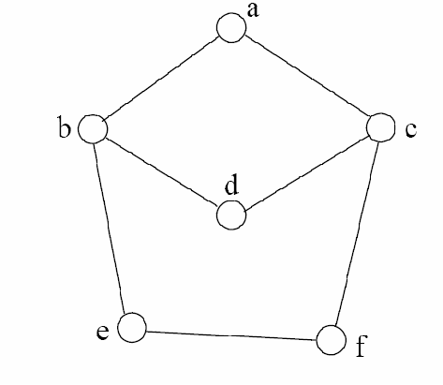
Path Examples
Are these paths?
Any cycles?
What is the path’s length?
{a,c,f,e}
{a,b,d,c,f,e}
{a, c, d, b, d, c, f, e}
{a,c,d,b,a}
{a,c,f,e,b,d,c,a}

Slide 26
Exercises on Graph
CLRS – Chapter 22 – elementary Graph Algorithms
Exercise you have to solve: (Page 593)
22.1-5 (Square)
22.1-6 (Universal Sink)

Slide 27
Graph Traversal
Application example
Given a graph representation and a vertex s in the graph
Find paths from s to other vertices
Two common graph traversal algorithms
Breadth-First Search (BFS)
Find the shortest paths in an unweighted graph
Depth-First Search (DFS)
Topological sort
Find strongly connected components

Slide 28
BFS and Shortest Path Problem
Given any source vertex s, BFS visits the other vertices at increasing distances away from s. In doing so, BFS discovers paths from s to other vertices
What do we mean by “distance”? The number of edges on a path from s
Example
0
Consider s=vertex 1
8
2
Nodes at distance 1?
2, 3, 7, 9
1
2
s
9
1
1
Nodes at distance 2?
8, 6, 5, 4
7
1
3
6
2
4
1
5
Nodes at distance 3?
0
2
2

Slide 29
Graph Searching
Given: a graph G = (V, E), directed or undirected
Goal: methodically explore every vertex and every edge
Ultimately: build a tree on the graph
Pick a vertex as the root
Choose certain edges to produce a tree
Note: might also build a forest if graph is not connected

Slide 30
Breadth-First Search
“Explore” a graph, turning it into a tree
One vertex at a time
Expand frontier of explored vertices across the breadth of the frontier
Builds a tree over the graph
Pick a source vertex to be the root
Find (“discover”) its children, then their children, etc.

Slide 31
Breadth-First Search
Every vertex of a graph contains a color at every moment:
White vertices have not been discovered
All vertices start with white initially
Grey vertices are discovered but not fully explored
They may be adjacent to white vertices
Black vertices are discovered and fully explored
They are adjacent only to black and gray vertices
Explore vertices by scanning adjacency list of grey vertices

Slide 32
Breadth-First Search: The Code
Data: color[V], prev[V],d[V]
BFS(G) // starts from here
{
for each vertex u ∈ V-{s}
{
color[u]=WHITE;
prev[u]=NIL;
d[u]=inf;
}
color[s]=GRAY;
d[s]=0; prev[s]=NIL;
Q=empty;
ENQUEUE(Q,s);
While(Q not empty)
{
u = DEQUEUE(Q);
for each v ∈ adj[u]{
if (color[v] == WHITE){
color[v] = GREY;
d[v] = d[u] + 1;
prev[v] = u;
Enqueue(Q, v);
}
}
color[u] = BLACK;
}
}

Slide 33
Breadth-First Search: Example
r
s
t
u
∞
∞
∞
∞
∞
∞
∞
∞
v
w
x
y
Vertex | r | s | t | u | v | w | x | y
color | W | W | W | W | W | W | W | W
d | ∞ | ∞ | ∞ | ∞ | ∞ | ∞ | ∞ | ∞
prev | nil | nil | nil | nil | nil | nil | nil | nil

Slide 34
Breadth-First Search: Example
r
s
t
u
∞
0
∞
∞
∞
∞
∞
∞
v
w
x
y
Q:
s
vertex | r | s | t | u | v | w | x | y
Color | W | G | W | W | W | W | W | W
d | ∞ | 0 | ∞ | ∞ | ∞ | ∞ | ∞ | ∞
prev | nil | nil | nil | nil | nil | nil | nil | nil

Slide 35
Breadth-First Search: Example
r
s
t
u
1
0
∞
∞
∞
1
∞
∞
v
w
x
y
Q:
s
w
r
vertex | r | s | t | u | v | w | x | y
Color | G | B | W | W | W | G | W | W
d | 1 | 0 | ∞ | ∞ | ∞ | 1 | ∞ | ∞
prev | s | nil | nil | nil | nil | s | nil | nil

Slide 36
Breadth-First Search: Example
r
s
t
u
1
0
2
∞
∞
1
2
∞
v
w
x
y
Q:
s
w
r
t
x
vertex | r | s | t | u | V | w | X | y
Color | G | B | G | W | W | B | G | W
d | 1 | 0 | 2 | ∞ | ∞ | 1 | 2 | ∞
prev | s | nil | w | nil | nil | s | w | nil

Slide 37
Breadth-First Search: Example
r
s
t
u
1
0
2
∞
2
1
2
∞
v
w
x
y
Q:
s
w
r
t
x
v
vertex | r | s | t | u | v | w | x | y
Color | B | B | G | W | G | B | G | W
d | 1 | 0 | 2 | ∞ | 2 | 1 | 2 | ∞
prev | s | nil | w | nil | r | s | w | nil

Slide 38
Breadth-First Search: Example
r
s
t
u
1
0
2
3
2
1
2
∞
v
w
x
y
Q:
s
w
r
t
x
v
u
vertex | r | s | t | u | v | w | x | y
Color | B | B | B | G | G | B | G | W
d | 1 | 0 | 2 | 3 | 2 | 1 | 2 | ∞
prev | s | nil | w | t | r | s | w | nil

Slide 39
Breadth-First Search: Example
r
s
t
u
1
0
2
3
2
1
2
3
v
w
x
y
Q:
s
w
r
t
x
v
u
y
vertex | r | s | t | u | v | w | x | y
Color | B | B | B | G | G | B | B | G
d | 1 | 0 | 2 | 3 | 2 | 1 | 2 | 3
prev | s | nil | w | t | r | s | w | x

Slide 40
Breadth-First Search: Example
r
s
t
u
1
0
2
3
2
1
2
3
v
w
x
y
Q:
s
w
r
t
x
v
u
y
vertex | r | s | t | u | v | w | x | y
Color | B | B | B | G | B | B | B | G
d | 1 | 0 | 2 | 3 | 2 | 1 | 2 | 3
prev | s | nil | w | t | r | s | w | x

Slide 41
Breadth-First Search: Example
r
s
t
u
1
0
2
3
2
1
2
3
v
w
x
y
Q:
s
w
r
t
x
v
u
y
vertex | r | s | t | u | v | w | x | y
Color | B | B | B | B | B | B | B | G
d | 1 | 0 | 2 | 3 | 2 | 1 | 2 | 3
prev | s | nil | w | t | r | s | w | x

Slide 42
Breadth-First Search: Example
r
s
t
u
1
0
2
3
2
1
2
3
v
w
x
y
Q:
s
w
r
t
x
v
u
y
vertex | r | s | t | u | v | w | x | y
Color | B | B | B | G | B | B | B | B
d | 1 | 0 | 2 | 3 | 2 | 1 | 2 | 3
prev | s | nil | w | t | r | s | w | x

Slide 43
BFS: The Code (again)
Data: color[V], prev[V],d[V]
BFS(G) // starts from here
{
for each vertex u ∈ V-{s}
{
color[u]=WHITE;
prev[u]=NIL;
d[u]=inf;
}
color[s]=GRAY;
d[s]=0; prev[s]=NIL;
Q=empty;
ENQUEUE(Q,s);
While(Q not empty)
{
u = DEQUEUE(Q);
for each v ∈ adj[u]{
if (color[v] == WHITE){
color[v] = GREY;
d[v] = d[u] + 1;
prev[v] = u;
Enqueue(Q, v);
}
}
color[u] = BLACK;
}
}

Slide 44
Breadth-First Search: Print Path
Data: color[V], prev[V],d[V]
Print-Path(G, s, v)
{
if(v==s)
print(s)
else if(prev[v]==NIL)
print(No path);
else{
Print-Path(G,s,prev[v]);
print(v);
}
}

Slide 45
BFS: Complexity
Data: color[V], prev[V],d[V]
BFS(G) // starts from here
{
for each vertex u ∈ V-{s}
{
color[u]=WHITE;
prev[u]=NIL;
d[u]=inf;
}
color[s]=GRAY;
d[s]=0; prev[s]=NIL;
Q=empty;
ENQUEUE(Q,s);
While(Q not empty)
{
u = DEQUEUE(Q);
for each v ∈ adj[u]{
if(color[v] == WHITE){
color[v] = GREY;
d[v] = d[u] + 1;
prev[v] = u;
Enqueue(Q, v);
}
}
color[u] = BLACK;
}
}
u = every vertex, but only once (Why?)
O(V)
O(V)
What will be the running time?
Total running time: O(V+E)

Slide 46
Breadth-First Search: Properties
BFS calculates the shortest-path distance to the source node
Shortest-path distance δ(s,v) = minimum number of edges from s to v, or ∞ if v not reachable from s
Proof given in the book (p. 472-5)
BFS builds breadth-first tree, in which paths to root represent shortest paths in G
Thus can use BFS to calculate shortest path from one vertex to another in O(V+E) time

Slide 47
Application of BFS
Find the shortest path in an undirected/directed unweighted graph.
Find the bipartite-ness of a graph.
Find cycle in a graph.
Find the connectedness of a graph.
And many more.

Slide 48
Exercises on BFS
CLRS – Chapter 22 – elementary Graph Algorithms
Exercise you have to solve: (Page 602)
22.2-7 (Wrestler)
22.2-8 (Diameter)
22.2-9 (Traverse)

Slide 49
Depth-First Search
Input:
G = (V, E) (No source vertex given!)
Goal:
Explore the edges of G to “discover” every vertex in V starting at the most current visited node
Search may be repeated from multiple sources
Output:
2 timestamps on each vertex:
d[v] = discovery time
f[v] = finishing time (done with examining v’s adjacency list)
Depth-first forest
1
2
3
5
4

Slide 50
Depth-First Search
Search “deeper” in the graph whenever possible
Edges are explored out of the most recently discovered vertex v that still has unexplored edges
2
1
3
5
4
After all edges of v have been explored, the search “backtracks” from the parent of v
The process continues until all vertices reachable from the original source have been discovered
If undiscovered vertices remain, choose one of them as a new source and repeat the search from that vertex
DFS creates a “depth-first forest”

Slide 51
DFS Additional Data Structures
Global variable: time-stamp
Incremented when nodes are discovered or finished
color[u] – similar to BFS
White before discovery, gray while processing and black when finished processing
prev[u] – predecessor of u
d[u], f[u] – discovery and finish times
1 ≤ d[u] < f [u] ≤ 2 |V|
WHITE
GRAY
BLACK
0
d[u]
f[u]
2V

Slide 52
Depth-First Search: The Code
Data: color[V], time, prev[V],d[V], f[V]
DFS(G) // where prog starts
{
for each vertex u ∈ V
{
color[u] = WHITE;
prev[u]=NIL;
f[u]=inf; d[u]=inf;
}
time = 0;
for each vertex u ∈ V
if (color[u] == WHITE)
DFS_Visit(u);
}
DFS_Visit(u)
{
color[u] = GREY;
time = time+1;
d[u] = time;
for each v ∈ Adj[u]
{
if(color[v] == WHITE){
prev[v]=u;
DFS_Visit(v);}
}
color[u] = BLACK;
time = time+1;
f[u] = time;
}
Initialize

Slide 53
Depth-First Search: The Code
Data: color[V], time, prev[V],d[V], f[V]
DFS(G) // where prog starts
{
for each vertex u ∈ V
{
color[u] = WHITE;
prev[u]=NIL;
f[u]=inf; d[u]=inf;
}
time = 0;
for each vertex u ∈ V
if (color[u] == WHITE)
DFS_Visit(u);
}
DFS_Visit(u)
{
color[u] = GREY;
time = time+1;
d[u] = time;
for each v ∈ Adj[u]
{
if(color[v] == WHITE){
prev[v]=u;
DFS_Visit(v);}
}
color[u] = BLACK;
time = time+1;
f[u] = time;
}
What does d[u] represent?

Slide 54
Depth-First Search: The Code
Data: color[V], time, prev[V],d[V], f[V]
DFS(G) // where prog starts
{
for each vertex u ∈ V
{
color[u] = WHITE;
prev[u]=NIL;
f[u]=inf; d[u]=inf;
}
time = 0;
for each vertex u ∈ V
if (color[u] == WHITE)
DFS_Visit(u);
}
DFS_Visit(u)
{
color[u] = GREY;
time = time+1;
d[u] = time;
for each v ∈ Adj[u]
{
if(color[v] == WHITE){
prev[v]=u;
DFS_Visit(v);}
}
color[u] = BLACK;
time = time+1;
f[u] = time;
}
What does f[u] represent?

Slide 55
Depth-First Search: The Code
Data: color[V], time, prev[V],d[V], f[V]
DFS(G) // where prog starts
{
for each vertex u ∈ V
{
color[u] = WHITE;
prev[u]=NIL;
f[u]=inf; d[u]=inf;
}
time = 0;
for each vertex u ∈ V
if (color[u] == WHITE)
DFS_Visit(u);
}
DFS_Visit(u)
{
color[u] = GREY;
time = time+1;
d[u] = time;
for each v ∈ Adj[u]
{
if(color[v] == WHITE){
prev[v]=u;
DFS_Visit(v);
}}
color[u] = BLACK;
time = time+1;
f[u] = time;
}
Will all vertices eventually be colored black?

Slide 56
DFS Example
source vertex
S
D
F
A
E
B
C
G

Slide 57
DFS Example
source vertex
d f
F
S
D
1 |
|
|
A
|
|
E
|
|
|
B
C
G

Slide 58
DFS Example
source vertex
d f
F
S
D
1 |
|
|
A
2 |
|
E
|
|
|
B
C
G

Slide 59
DFS Example
source vertex
d f
F
S
D
1 |
|
|
A
2 |
|
E
3 |
|
|
B
C
G

Slide 60
DFS Example
source vertex
d f
F
S
D
1 |
|
|
A
2 |
|
E
3 | 4
|
|
B
C
G

Slide 61
DFS Example
source vertex
d f
F
S
D
1 |
|
|
A
2 |
|
E
3 | 4
5 |
|
B
C
G

Slide 62
DFS Example
source vertex
d f
F
S
D
1 |
|
|
A
2 |
|
E
3 | 4
5 | 6
|
B
C
G

Slide 63
DFS Example
source vertex
d f
F
S
D
1 |
|
|
A
2 | 7
|
E
3 | 4
5 | 6
|
B
C
G

Slide 64
DFS Example
source vertex
d f
F
S
D
1 |
8 |
|
A
2 | 7
|
E
3 | 4
5 | 6
|
B
C
G

Slide 65
DFS Example
source vertex
d f
F
S
D
1 |
8 |
|
A
2 | 7
9 |
E
3 | 4
5 | 6
|
B
C
G
What is the structure of the grey vertices? What do they represent?

Slide 66
DFS Example
source vertex
d f
F
S
D
1 |
8 |
|
A
2 | 7
9 |10
E
3 | 4
5 | 6
|
B
C
G

Slide 67
DFS Example
source vertex
d f
F
S
D
1 |
8 |11
|
A
2 | 7
9 |10
E
3 | 4
5 | 6
|
B
C
G

Slide 68
DFS Example
source vertex
d f
F
S
D
1 |12
8 |11
|
A
2 | 7
9 |10
E
3 | 4
5 | 6
|
B
C
G

Slide 69
DFS Example
source vertex
d f
F
S
D
1 |12
8 |11
13|
A
2 | 7
9 |10
E
3 | 4
5 | 6
|
B
C
G

Slide 70
DFS Example
source vertex
d f
F
S
D
1 |12
8 |11
13|
A
2 | 7
9 |10
E
3 | 4
5 | 6
14|
B
C
G

Slide 71
DFS Example
source vertex
d f
F
S
D
1 |12
8 |11
13|
A
2 | 7
9 |10
E
3 | 4
5 | 6
14|15
B
C
G

Slide 72
DFS Example
source vertex
d f
F
S
D
1 |12
8 |11
13|16
A
2 | 7
9 |10
E
3 | 4
5 | 6
14|15
B
C
G

Slide 73
Depth-First Search: The Code
Data: color[V], time, prev[V],d[V], f[V]
DFS(G) // where prog starts
{
for each vertex u ∈ V
{
color[u] = WHITE;
prev[u]=NIL;
f[u]=inf; d[u]=inf;
}
time = 0;
for each vertex u ∈ V
if (color[u] == WHITE)
DFS_Visit(u);
}
DFS_Visit(u)
{
color[u] = GREY;
time = time+1;
d[u] = time;
for each v ∈ Adj[u]
{
if (color[v] == WHITE)
prev[v]=u;
DFS_Visit(v);
}
color[u] = BLACK;
time = time+1;
f[u] = time;
}
What will be the running time?

Slide 74
Depth-First Search: The Code
Data: color[V], time, prev[V],d[V], f[V]
DFS(G) // where prog starts
{
for each vertex u ∈ V
{
color[u] = WHITE;
prev[u]=NIL;
f[u]=inf; d[u]=inf;
}
time = 0;
for each vertex u ∈ V
if (color[u] == WHITE)
DFS_Visit(u);
}
DFS_Visit(u)
{
color[u] = GREY;
time = time+1;
d[u] = time;
for each v ∈ Adj[u]
{
if (color[v] == WHITE)
prev[v]=u;
DFS_Visit(v);
}
color[u] = BLACK;
time = time+1;
f[u] = time;
}
O(V)
O(V)
O(V)
Running time: O(V²) because call DFS_Visit on each vertex, and the loop over Adj[] can run as many as |V| times

Slide 75
Depth-First Search: The Code
Data: color[V], time, prev[V],d[V], f[V]
DFS(G) // where prog starts
{
for each vertex u ∈ V
{
color[u] = WHITE;
prev[u]=NIL;
f[u]=inf; d[u]=inf;
}
time = 0;
for each vertex u ∈ V
if (color[u] == WHITE)
DFS_Visit(u);
}
DFS_Visit(u)
{
color[u] = GREY;
time = time+1;
d[u] = time;
for each v ∈ Adj[u]
{
if (color[v] == WHITE)
prev[v]=u;
DFS_Visit(v);
}
color[u] = BLACK;
time = time+1;
f[u] = time;
}
BUT, there is actually a tighter bound. How many times will DFS_Visit() actually be called?

Slide 76
Depth-First Search: The Code
Data: color[V], time, prev[V],d[V], f[V]
DFS(G) // where prog starts
{
for each vertex u ∈ V
{
color[u] = WHITE;
prev[u]=NIL;
f[u]=inf; d[u]=inf;
}
time = 0;
for each vertex u ∈ V
if (color[u] == WHITE)
DFS_Visit(u);
}
DFS_Visit(u)
{
color[u] = GREY;
time = time+1;
d[u] = time;
for each v ∈ Adj[u]
{
if (color[v] == WHITE)
prev[v]=u;
DFS_Visit(v);
}
color[u] = BLACK;
time = time+1;
f[u] = time;
}
So, running time of DFS = O(V+E)

Slide 77
Depth-First Sort Analysis
This running time argument is an informal example of amortized analysis
“Charge” the exploration of edge to the edge:
Each loop in DFS_Visit can be attributed to an edge in the graph
Runs once per edge if directed graph, twice if undirected
Thus loop will run in O(E) time, algorithm O(V+E)
Considered linear for graph, b/c adj list requires O(V+E) storage
Important to be comfortable with this kind of reasoning and analysis

Slide 78
DFS: Kinds of edges
DFS introduces an important distinction among edges in the original graph:
Tree edge: encounter new (white) vertex
The tree edges form a spanning forest
Can tree edges form cycles? Why or why not?
No

Slide 79
DFS Example
source vertex
d f
1 |12
8 |11
13|16
2 | 7
9 |10
3 | 4
5 | 6
14|15
Tree edges

Slide 80
DFS: Kinds of edges
DFS introduces an important distinction among edges in the original graph:
Tree edge: encounter new (white) vertex
Back edge: from descendent to ancestor
Encounter a grey vertex (grey to grey)
Self loops are considered as to be back edge.

Slide 81
DFS Example
source vertex
d f
1 |12
8 |11
13|16
2 | 7
9 |10
3 | 4
5 | 6
14|15
Tree edges
Back edges

Slide 82
DFS: Kinds of edges
DFS introduces an important distinction among edges in the original graph:
Tree edge: encounter new (white) vertex
Back edge: from descendent to ancestor
Forward edge: from ancestor to descendent
Not a tree edge, though
From grey node to black node

Slide 83
DFS Example
source vertex
d f
1 |12
8 |11
13|16
2 | 7
9 |10
3 | 4
5 | 6
14|15
Tree edges
Back edges
Forward edges

Slide 84
DFS: Kinds of edges
DFS introduces an important distinction among edges in the original graph:
Tree edge: encounter new (white) vertex
Back edge: from descendent to ancestor
Forward edge: from ancestor to descendent
Cross edge: between a tree or subtrees
From a grey node to a black node

Slide 85
DFS Example
source vertex
d f
1 |12
8 |11
13|16
2 | 7
9 |10
3 | 4
5 | 6
14|15
Tree edges
Back edges
Forward edges
Cross edges

Slide 86
DFS: Kinds of edges
DFS introduces an important distinction among edges in the original graph:
Tree edge: encounter new (white) vertex
Back edge: from descendent to ancestor
Forward edge: from ancestor to descendent
Cross edge: between a tree or subtrees
Note: tree & back edges are important; most algorithms don’t distinguish forward & cross

Slide 87
More about the edges
Let (u,v) is an edge.
If (color[v] = WHITE) then (u,v) is a tree edge
If (color[v] = GRAY) then (u,v) is a back edge
If (color[v] = BLACK) then (u,v) is a forward/cross edge
Forward Edge: d[u]<d[v]
Cross Edge: d[u]>d[v]

Slide 88
Depth-First Search - Timestamps
a
b
s
c
3/6
2/9
1/10
11/16
B
F
C
B
4/5
7/8
12/13
14/15
C
C
C
d
e
f
g

Slide 89
Depth-First Search - Timestamps
s
c
C
B
F
b
f
g
C
a
e
C
B
C
d

Slide 90
Depth-First Search: Detect Edge
Data: color[V], time, prev[V],d[V], f[V]
DFS(G) // where prog starts
{
for each vertex u ∈ V
{
color[u] = WHITE;
prev[u]=NIL;
f[u]=inf; d[u]=inf;
}
time = 0;
for each vertex u ∈ V
if (color[u] == WHITE)
DFS_Visit(u);
}
DFS_Visit(u)
{
color[u] = GREY;
time = time+1;
d[u] = time;
for each v ∈ Adj[u]
{
detect edge type using “color[v]”
if(color[v] == WHITE){
prev[v]=u;
DFS_Visit(v);
}}
color[u] = BLACK;
time = time+1;
f[u] = time;
}

Slide 91
DFS: Kinds Of Edges
Thm 22.10: If G is undirected, a DFS produces only tree and back edges
Proof by contradiction:
Assume there’s a forward edge
But F? edge must actually be a back edge (why?)
source
F?

Slide 92
DFS: Kinds Of Edges
Thm 22.10: If G is undirected, a DFS produces only tree and back edges
Proof by contradiction:
Assume there’s a cross edge
But C? edge cannot be cross:
must be explored from one of the vertices it connects, becoming a tree vertex, before other vertex is explored
So in fact the picture is wrong…both lower tree edges cannot in fact be tree edges
source
C?

Slide 93
DFS And Graph Cycles
Thm: An undirected graph is acyclic iff a DFS yields no back edges
If acyclic, no back edges (because a back edge implies a cycle
If no back edges, acyclic
No back edges implies only tree edges (Why?)
Only tree edges implies we have a tree or a forest
Which by definition is acyclic
Thus, can run DFS to find whether a graph has a cycle

Slide 94
DFS And Cycles
How would you modify the code to detect cycles?
Data: color[V], time, prev[V],d[V], f[V]
DFS(G) // where prog starts
{
for each vertex u ∈ V
{
color[u] = WHITE;
prev[u]=NIL;
f[u]=inf; d[u]=inf;
}
time = 0;
for each vertex u ∈ V
if (color[u] == WHITE)
DFS_Visit(u);
}
DFS_Visit(u)
{
color[u] = GREY;
time = time+1;
d[u] = time;
for each v ∈ Adj[u]
{
if (color[v]==WHITE){
prev[v]=u;
DFS_Visit(v);
}
}
color[u] = BLACK;
time = time+1;
f[u] = time;
}

Slide 95
DFS And Cycles
What will be the running time?
Data: color[V], time, prev[V],d[V], f[V]
DFS(G) // where prog starts
{
for each vertex u ∈ V
{
color[u] = WHITE;
prev[u]=NIL;
f[u]=inf; d[u]=inf;
}
time = 0;
for each vertex u ∈ V
if (color[u] == WHITE)
DFS_Visit(u);
}
DFS_Visit(u)
{
color[u] = GREY;
time = time+1;
d[u] = time;
for each v ∈ Adj[u]
{
if (color[v]==WHITE){
prev[v]=u;
DFS_Visit(v); }
else {cycle exists;}
}
color[u] = BLACK;
time = time+1;
f[u] = time;
}

Slide 96
DFS And Cycles
What will be the running time for undirected graph to detect cycle?
A: O(V+E)
We can actually determine if cycles exist in O(V) time
How??

Slide 97
DFS And Cycles
What will be the running time for undirected graph to detect cycle?
A: O(V+E)
We can actually determine if cycles exist in O(V) time:
In an undirected acyclic forest, |E| ≤ |V| - 1
So count the edges: if ever see |V| distinct edges, must have seen a back edge along the way

Slide 98
DFS And Cycles
What will be the running time for directed graph to detect cycle?
A: O(V+E)

Slide 99
Exercises on DFS
CLRS Chapter 22 (Elementary Graph Algorithms)
Exercise: (Page
22.3-5 –Detect edge using d[u], d[v], f[u], f[v]
22.3-12 – Connected Component
22.3-13 – Singly connected

Slide 100
Some applications of BFS and DFS
Topological Sort (Topic of Next Lecture)
Euler Path (Topic of Next Lecture)
Dictionary Search
Mathematical Problem
Grid Traversal

Slide 101
The idea of State/Node
Parameters describing a scenario
Useless Parameters
If value of the parameter change doesn’t affect the outcome
If value of the parameter can be derived from other parameters
Useful Parameter
Not useless!!!

Slide 102
Example - States
Grid Problem, direction change takes time
Grid Problem, blocks alternating

